Slide 1
Lesson 9:
Programming in Python

Slide 2
Let’s get back to our project

Slide 3
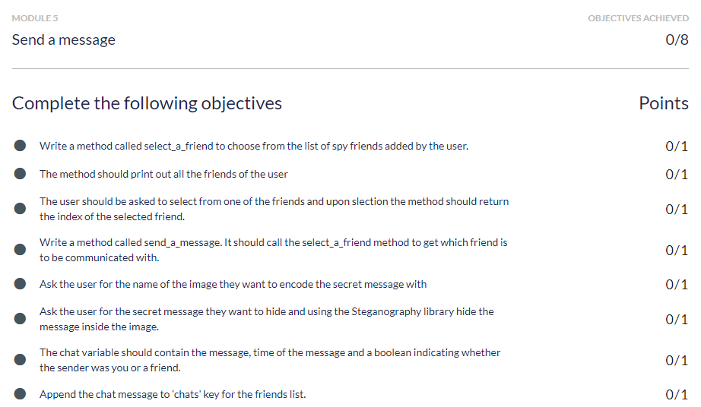
Objective for this week

Slide 4
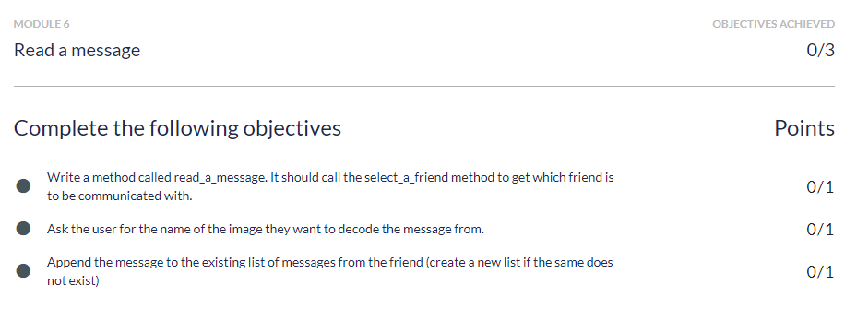
Objective for this week

Slide 5
Well, what modules have we built in our spychat project
Profile of a spy
A menu of choices
Status message for a spy
Add a spy friend
Send and read a secret message(today)
Save chats

Slide 6
Feature :
Send secret message to the friend.

Slide 7
Send secret message to the friend
To send someone a message on any social media platform( Facebook / Whatsapp), we need to make a selection in contacts first.
Let us create a function select_a_friend to choose from the list of spy friends added by the user.
This function will:
Print out all the friends of the user.
Ask the user to select from one of the friends.
Return the index of the selected friend in the friends list.

Slide 8
Sending message to a friend
def select_friend():
item_number = 0
#Printing all the friends of a User
for friend in friends:
print('%d. %s' % (item_number + 1), friend['name'])
item_number = item_number + 1
#Asking the user to select a friend
friend_choice = input("Choose from your friends")
friend_choice_position = friend_choice - 1
#Returning the index
return friend_choice_position

Slide 9
Today's class is about sending and receiving a secret message.
Let’s figure out how would that work?

Slide 10
Cryptography vs Steganography
What is Cryptography?
Cryptography is a method of storing and transmitting data in a particular form so that only the intended recipients can read and process it. In cryptography, the message or communication is obscured so that it cannot be understood by another party.
What is Steganography?
Steganography is a method of concealing messages or information within a non-secret document or another medium.
In Steganography, since the message is hidden inside another message or communication, there is no way of knowing that a secret communication is taking place. It is accurate to say that it is a method of sending a secret message in such a way that no one except the sender and the intended recipient knows that communication is taking place.

Slide 11
To send the hidden message we would be using an external python library.
So let's understand python libraries.

Slide 12
A library in Python is basically a collection of code made by others which can be re-used in our program.
These libraries help us to implement specific functionalities in our application using very few lines of code.
The Python libraries are written by none other than our fellow developers and coding professionals who have extensive knowledge of the language.
There are many libraries available in Python. Chances are, that whatever you need to do, there is a python library helping with that.
Introduction to Python Libraries

Slide 13
To install python libraries open up anaconda command prompt and type-in
pip install <name_of_the_module>
2. We will now add the following line to our spychat python file from steganography.steganography import Steganography
Installing Python Libraries

Slide 14
encode() : The encode function takes the secret message, the image, and the output path as input and creates the image with the hidden secret message at the output path.
2. decode(): The decode function takes the image with the hidden secret message as input and returns the secret text.
Functions in steganography module
Steganography.encode(original_image, output_path, text)
secret_text = Steganography.decode(output_path)

Slide 15
Sending a secret message.
Let us create a function send_message() to send message.
We call the function select_a_friend() which returns the position of the friend to whom we need to send the message and store it in a variable select_friend.
Now, we proceed to create the secret message that we need to send. The steps to be followed are:
Input and store the original image upon which the message will be encoded in a variable original_image.
Store the path of the output image which will carry our secret message in a variable output_path.
Input and store the secret message in a variable text.
Encode the secret message using the encode() function from Steganography module.

Slide 16
Sending a secret message.
def send_message():
friend_choice = select_a_friend()
original_image = input("What is the name of the image?")
output_path = 'output.jpg'
text = input("What do you want to say?")
Steganography.encode(original_image, output_path, text)

Slide 17
Reading a secret message.
Let us create a function read_message() to send message.
Again, we call the function select_a_friend() to gain the index of the friend whose message is to be read.
Now, we proceed to decode the secret message that we need to read. The steps to be followed are:
Input and store the image that needs to be decoded in a variable output_path.
Decode and save the secret message in a variable secret_text using the decode() function from Steganography module.

Slide 18
Reading a secret message.
def read_message():
sender = select_a_friend()
output_path = input("What is the name of the file?")
secret_text = Steganography.decode(output_path)

Slide 19
Now there is always a date and time related to each and every message/email that you send or receive on the internet.
This is called a Timestamp

Slide 20
Time Stamp
We introduce another module to handle date and time related operations called datetime module available in Python. The datetime module provides classes for manipulating dates and times.
Let's start by importing the module.
The most important functions included in datetime module is now(). This function returns the current local date and time.
from datetime import datetime
current_time = datetime.now()

Slide 21
Encoding a secret message with timestamp
Now we proceed to save the secret message that we created in the send_message() function along with the current timestamp.
def send_message()
...
new_chat = {
"message": text,
"time": datetime.now(),
"sent_by_me": True
}
friend[friend_choice]['chats'].append(new_chat)
print("Your secret message is ready!")

Slide 22
Decoding a secret message with timestamp
To save the secret message that we decoded in the read_message() function along with the current timestamp.
def read_message()
...
new_chat = {
"message": secret_text,
"time": datetime.now(),
"sent_by_me": False
}
friend[sender]['chats'].append(new_chat)
print("Your secret message has been saved!")

Slide 23
Our project is nearly done

Slide 24
Well, what modules have we built in our spychat project
Profile of a spy
A menu of choices
Status message for a spy
Add a spy friend
Send and read a secret message
Save chats

Slide 25
Let us briefly discuss some new ideas that you can implement in your project by yourself
Implement a login system

Slide 26
In the past few classes we used simple python variables and then dictionaries to store various properties about a spy user (such as name, age, rating)
In the last class we even refactored our code to wrap up the different variables into a dictionary.
But now we are going to discuss wrapping the same variables into a class instead.
But the big question is why?
We created the spy variable twice, once when we were defining our own user and second time when adding a friend spy. Both times we had to define the dictionary again.
Even though both dictionaries had the same keys we had to repeat our code. Repetition can lead to errors. This is exactly why we define classes, to reuse our code without writing it again and again. To define what a concept/object should be for once and once alone.

Slide 27
Till now, we were using dictionaries to store and implement data. Things were going smooth, so why is there a sudden need to move to classes. Look at this code snippet:
new_friend = {
'name': '',
'salutation': '',
'age': 0,
'rating': 0.0,
'chats': []
}
By now you are very much familiar with what this code does.

Slide 28
We’ll continue in next class..
Any questions?

